Slide 1
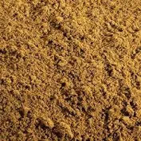
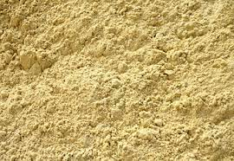
Building And Plastering Materials
1. River sand
- It is used for making surfaces or floors
2. Plaster sand
- It is used plastering walls.

Slide 2
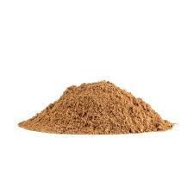
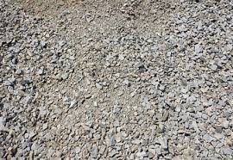
3. Building sand
- It is used for building walls.
4. Concrete mix
- It is used for making foundations and floors.

Slide 3
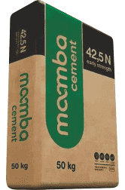

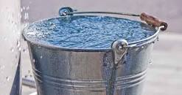
5. Cement
- It is used for mixing with sands or concrete mix and water to make mortar.
6. Water
- It is used for mixing with sands or concrete mix and cement to make mortar.

Slide 4
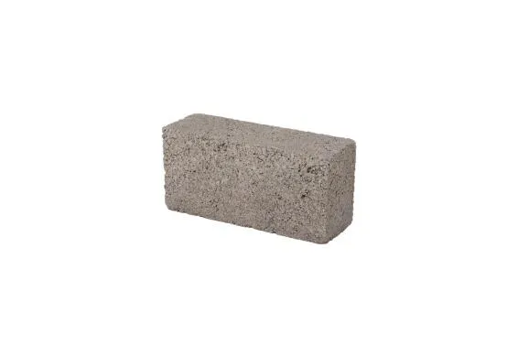
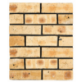
7. Stock bricks
- It is used for building walls.
8. Maxi bricks
- It is used for building walls.

Slide 5
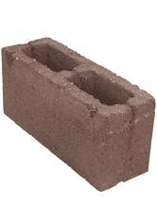
9. Blocks bricks
It is used for building walls.
Demonstration Video :
-
Feedback : Activity

Slide 6
Feedback
Activity : Worksheet 2
Kwa Thema Skills School
Subject : Maintenance Marks: 12
Grade : Year 2 Time : 30mins
Date :
Question : 1
1.Name any five building and plastering materials.
1.1 ________________________
1.2 ________________________
1.3 ________________________
1.4 ________________________
1.5 ________________________
(5)

Slide 7
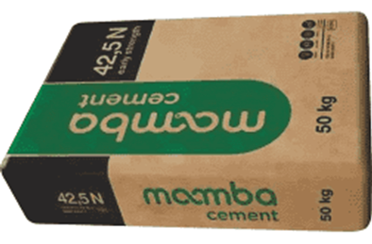
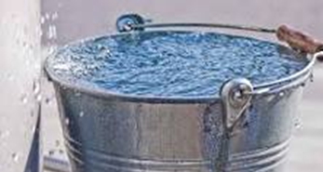
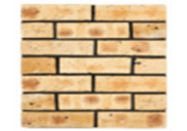

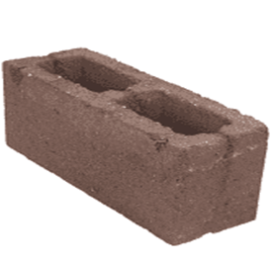
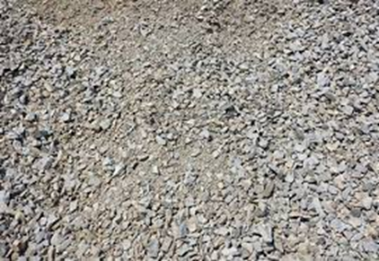
Question:2
1.Identify the following building and plastering materials.
1.____________________ 2.______________________
3.___________________ 4. ______________________
5. ______________________ 6. ______________________

Slide 8
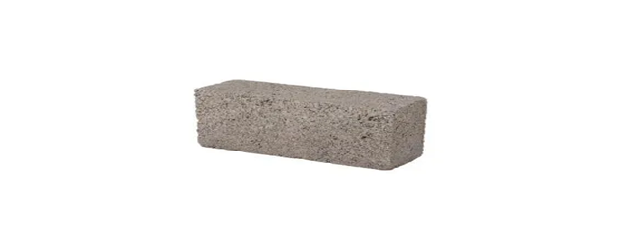
7. ____________________ 8.______________________
(8)

